Slide 1

Flip Robo Technologies: Internship Batch 34
E-retail factors for customer activation and retention: A case study from Indian e-commerce customers.

Slide 2
1. INTRODUCTION

Slide 3
INTRODUCTION
Customer relationship management (CRM) supports marketing by selecting target consumers and creating cost-effective relationships with them. CRM is the process of understanding customer behavior in order to support organization to improve customer acquisition, retention, and profitability. Thus, CRM systems utilize business intelligence and analytical models to identify the most profitable group of consumers and target them achieve higher customer retention rates. Those models can predict customers with high probability to churn based on analyzing customers’ personal, demographic and behavioral data to provide personalized and customer-oriented marketing campaigns to gain customer satisfaction.

Slide 4
CRM INCLUDES 4 MAIN STAGES
Identification
Retention
Attraction
Development

Slide 5
CUSTOMER ACTIVATION
Customer activation is an act of motivating customers to completely realize the benefits of the product or services they are testing, hence increasing their overall engagement. the result could be acquiring a new customer or re-engaging an inactive one.
Activating the customer does really matter in order to stop them from ending their buyer’s journey and continue being an active customer. As marketing leaders, you need to identify the factors that stopping your customers from continuing their buyer’s journey. Doing this may influence customers’ movement in their life cycle a step closer to a purchase.

Slide 6
CUSTOMER ACTIVATION STRATEGIES
01
02
03
04
05
Know your customers
Create your buyer personas
Identify customer online behavior
Create your customer journey map
Identify customer stage and speed

Slide 7
CUSTOMER RETENTION
Customer retention is a business’s ability to keep existing customers and continue to generate revenue from them. Companies use different tactics to convert first-time buyers into repeat shoppers. In other words, customer retention allows a business to increase the profitability of an existing customer and maximize their lifetime value (LTV).
Customer retention is vital in driving repeat purchases and ongoing value from your customer base. One oft-cited rule of thumb is that it costs five times as much to acquire a new customer as it does to retain an existing customer.

Slide 8
CUSTOMER RETENTION BENEFITS
01
02
03
04
Increased profits
Lower costs
Increased average order value (AOV)
Acquire brand ambassadors

Slide 9
RESEARCH OBJECTIVES
This research paper has the following objectives:
Identifying the impact of customer activation and retention of e-commerce Indian customers.
Factors affecting their buyer behaviour.
Predicting how many customers will recommend the e-commerce site to their friends/family. This is our target variable as this shows how much retention is the company gaining with customer’s word of mouth.

Slide 10
RESEARCH METHODOLOGY
RESEARCH DESIGN
The research design is the conceptual framework around which the survey is undertaken. Here a part of the research undertaken is a Exploratory Research as it is describing the perception of the respondents.
SAMPLE SIZE
The Sample Size is 256. Data has been collected and analysed on the basis of the responses. The research was conducted with an aim of getting respondents from all across India.

Slide 11
RESEARCH METHODOLOGY
PERIOD OF STUDY
The period of study was more than a week.
DATA COLLECTION
Primary Data- Dataset and excel sheet provided by Flip Robo technologies for project completion.
Secondary Data-The data includes reference from previously published research papers, journals, books and articles.
METHOD OF ANALYSIS
In this research, tables and various types of graphs such as bar graph and count plot have been used. This helped to present the data in a meaningful way and making it easily understandable.

Slide 12
2. STEPS USED IN PREDICTING CUSTOMER CHURN

Slide 13
2.1 Choosing the model

Slide 14
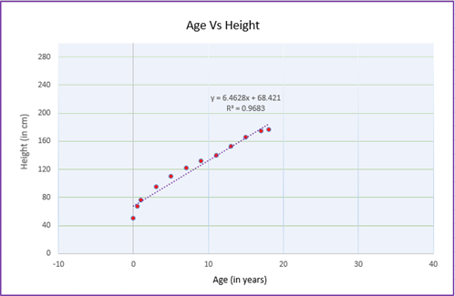
We will use LINEAR REGRESSION MODEL:
Linear regression is a machine learning algorithm which estimates how a model is following a linear relationship between one response variable (denoted by y) and one or more explanatory variables (denoted by X1, X2, X3…. Xn). The response variable will dependent on how the explanatory variables changes and not the other way round. Response variable is also known as target or dependent variable while the explanatory variable is known as independent or predictor variables.

Slide 15
2.2 Steps used in EDA & Preprocessing

Slide 16
Steps:
1. Identification of variables and data types
2. Analyzing the basic metrics
3. Non-Graphical Univariate Analysis
4. Missing value treatment
5. Graphical Univariate Analysis
6. Bivariate Analysis
7. Encoding the categorical Data
8. Outlier treatment
9. Variable transformations
10. Correlation Analysis
11. Dimensionality Reduction
12.Scaling of Independent features

Slide 17
2.3 Steps used in the Project

Slide 18
Steps:
1. We need to apply feature engineering/ EDA on the dataset. After that you can split the dataset into train_model and test_model; use this train_model to train your model and test_model to validate your model.
2. After splitting the dataset you need to train at least 4-5 models.
3. Check performance of each model
For regression problem- create regression model and check the r2 score and metrics of each model .
4. Check the cross validation score for each model(for classification as well as for regression model).
5. Choose the model as the best model.
For regression problem- model with least difference between performance parameter and cross validation computed on same performance parameter is the best model. Example- Difference between r2 score and cross validation computed on r2 scoring parameter.
6. Perform hyper parameter tuning on the best model and check performance of the best model.
7. Save the best model.

Slide 19
3. ANALYSIS: DATA FINDINGS AND INTERPRETATION

Slide 20
3.1 Data shapes and Data types

Slide 21
Shape of DataFrame:
The shape property returns a tuple containing the number of rows and columns of the DataFrame.
Data Types:
Pandas dtype mapping
Pandas dtype | Python type | NumPy type | Usage
object | str or mixed | string_, unicode_, mixed types | Text or mixed numeric and non-numeric values
int64 | Int | int_, int8, int16, int32, int64, uint8, uint16, uint32, uint64 | Integer numbers
float64 | Float | float_, float16, float32, float64 | Floating point numbers
bool | Bool | bool_ | True/False values
datetime64 | NA | datetime64[ns] | Date and time values
timedelta[ns] | NA | NA | Differences between two datetimes
category | NA | NA | Finite list of text values

Slide 22
3.2 Data Visualization To avoid confusion and errors, we name the columns from column1 to column71. We will use count plot for all columns as they are categorial data, except for column 4 which is continuous data. We will use distplot for that.

Slide 23
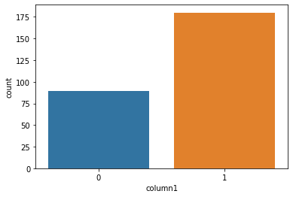
Column1- Gender of respondent
1 180
0 89
Here, 1 represents Female and 0 represents Male. We see that Female respondents are more in number for this data set than Male respondents.

Slide 24
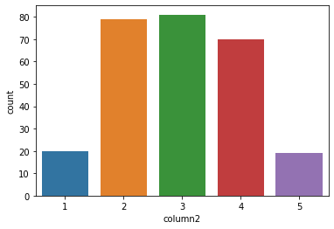
Column2- How old are you?
81
79
70
20
19
Here, 1 represents Less than 20 years, 2 represents 21-30 years, 3 represents 31-40 years, 4 represents 41-50 years and 5 represents 51 years and above. We see that, major respondents are of the age between 31-40 years.

Slide 25
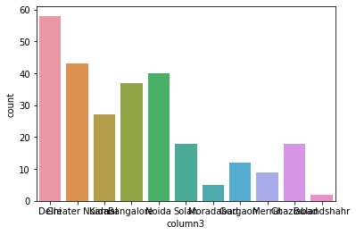
Column3- Which city do you shop online from?
Delhi 58
Greater Noida 43
Noida 40
Bangalore 37
Karnal 27
Solan 18
Ghaziabad 18
Gurgaon 12
Merrut 9
Moradabad 5
Bulandshahr 2
Here, we see that most respondents are shopping online from Delhi.

Slide 26
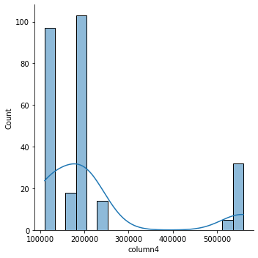
Column4- What is the pincode from where you shop online from?
We see that maximum respondents are from Greater Noida and Noida.

Slide 27
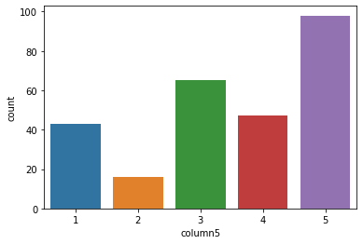
Column5- Since how long are you shopping online?
98
65
47
43
16
Here, 1 represents Less than 1 year, 2 represents 1-2 years, 3 represents 2-3 years, 4 represents 3-4 years and 5 represents More than 4 years. We see that, most respondents shop online more than 4 years.

Slide 28
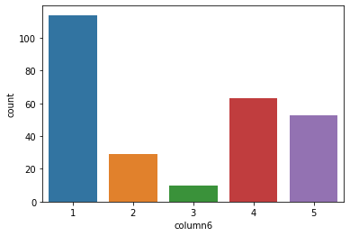
Column6- How many times have you made an online purchase in the last one year?
114
63
53
29
10
Here, 1 represents 41 times or more, 2 represents 31-40 times, 3 represents 21-30 times, 4 represents 11-20 times and 5 represents 11 times or less.
We see that, maximum number of respondents have purchased online more than 41 times.

Slide 29
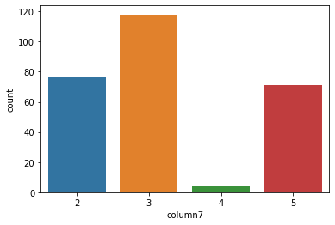
Column7- How do you access the internet while shopping on-line?
118
76
71
04
Here, 2 represents Wifi, 3 represents Mobile Internet, 4 represents Dial-up. We see that maximum of the respondents use Mobile Internet for online shopping.

Slide 30
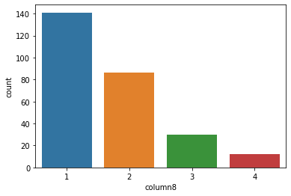
Column8- Which device do you use to access the online shopping?
141
86
30
12
Here, 1 represents Smartphone, 2 represents Laptop, 3 represents Desktop and 4 represents Tablet. We see that, most respondents use Smartphones to access online shopping sites.

Slide 31
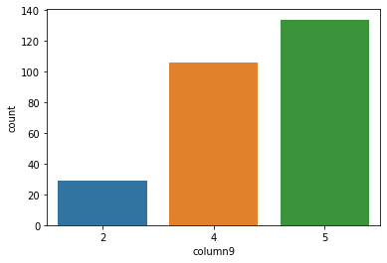
Column9- What is the screen size of your mobile device?
134
106
29
Here, 2 represents 4.7 inches, 4 represents 5.5 inches and 5 represents Others

Slide 32
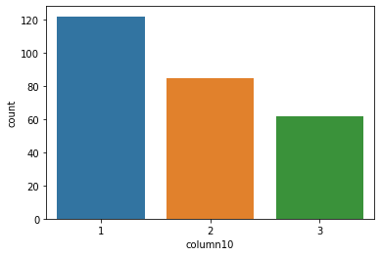
Column10- What is the operating system (OS) of your device?
122
85
62
Here, 1 represents Windows, 2 represents Android and 3 represents IOS/Mac. We see that, most respondents use Windows processor to shop online.

Slide 33
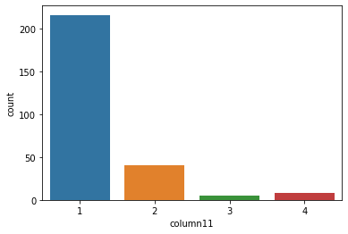
Column11- What browser do you run on your device to access the online site?
216
40
8
5
Here, we see that 1 which represents Google Chrome is being used by the maximum number of respondents.

Slide 34
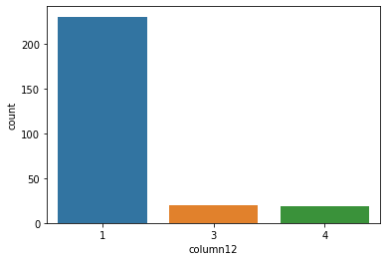
Column12- Which channel did you follow to arrive at your favourite online store for the first time?
230
20
19
Here we see that, 1 which represents Search Engine is being used by the maximum number of respondents.

Slide 35
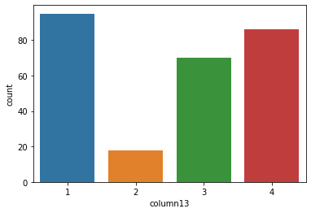
Column13- After first visit, how do you reach the online retail store?
95
86
70
18
Here we see that, 1 which represents Search Engine again is being used by maximum number of respondents. This also means that applications are in less use that search engine browsing.

Slide 36
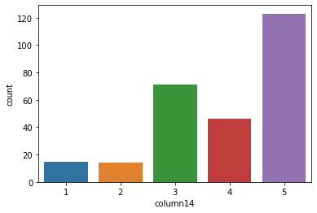
Column14- How much time do you explore the e- retail store before making a purchase decision?
123
71
46
15
14
Here we see that, 5 which represents more than 15 mins is the time being spent by maximum number of respondents. In this technological world where everything and all business is shifting online, people tend to spend more time on online shopping than offline as it is convenient and time saving.

Slide 37
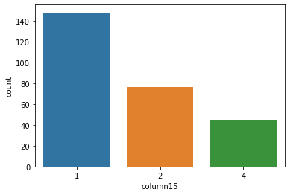
Column15- What is your preferred payment Option?
148
76
45
Here we see that, 1 which represents Credit/Debit cards is the most preferred by maximum shoppers. This is because it is safer and much more efficient as compared to other payment options.

Slide 38
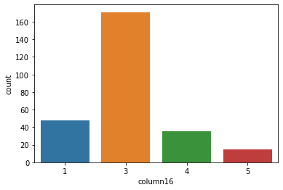
Column16- How frequently do you abandon (selecting an items and leaving without making payment) your shopping cart?
171
48
35
15
Here we see that, 3 which represents Sometimes is the choice of maximum respondents.

Slide 39
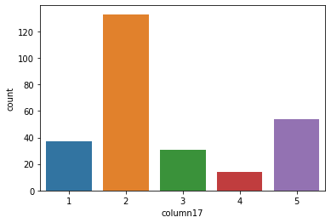
Column17- Why did you abandon the “Bag”, “Shopping Cart”?
133
54
37
31
14
Here we see that, 2 which represents better alternative offer is the choice of maximum respondents.

Slide 40
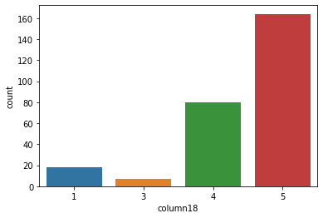
Column18- The content on the website must be easy to read and understand
164
80
18
7
Here we see that, 5 which represents strongly agree is the choice of maximum respondents. Most customers feel that the content should be legible and clear to understand.

Slide 41
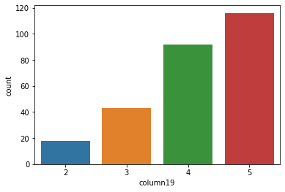
Column19- Information on similar product to the one highlighted is important for product comparison
116
92
43
18
Here we see that, strongly agree is the choice for most of the respondents.

Slide 42
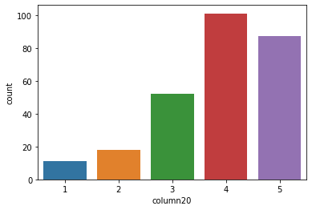
Column20- Complete information on listed seller and product being offered is important for purchase decision.
101
87
52
18
11
Here we see that, 4 which represents agree is the choice of maximum respondents.

Slide 43
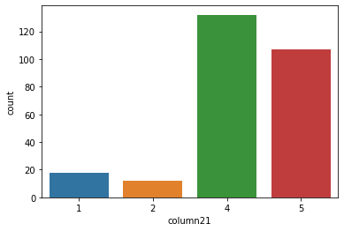
Column21- All relevant information on listed products must be stated clearly
132
107
18
12
Here we see that, 4 which represents agree is the choice of maximum respondents.

Slide 44
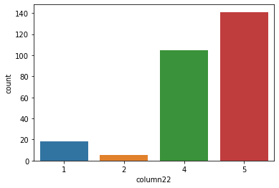
Column22- Ease of navigation in website
141
105
18
5
Here we see that, 5 which represents strongly agree is the choice of maximum respondents.

Slide 45
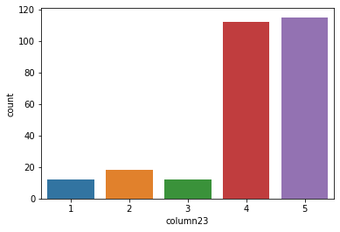
Column23- Loading and processing speed
115
112
18
12
12
Here we see that, 5 which represents strongly agree is the choice of maximum respondents.

Slide 46
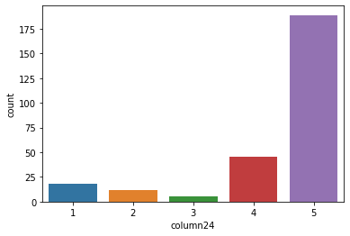
Column24- User friendly Interface of the website
189
45
18
12
5
Here we see that, 5 which represents strongly agree is the choice of maximum respondents.

Slide 47
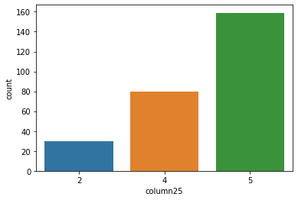
Column25- Convenient Payment methods
159
80
30
Here we see that, 5 which represents strongly agree is the choice of maximum respondents.

Slide 48
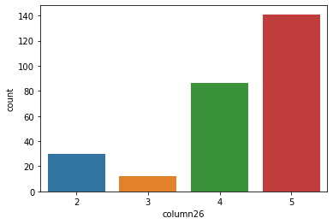
Column26- Trust that the online retail store will fulfill its part of the transaction at the stipulated time
141
86
30
12
Here we see that, 5 which represents strongly agree is the choice of maximum respondents.

Slide 49
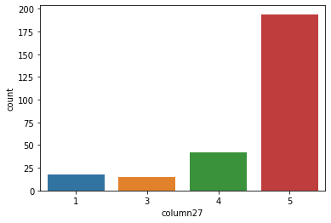
Column27- Empathy (readiness to assist with queries) towards the customers
194
42
18
15
Here we see that, 5 which represents strongly agree is the choice of maximum respondents.

Slide 50
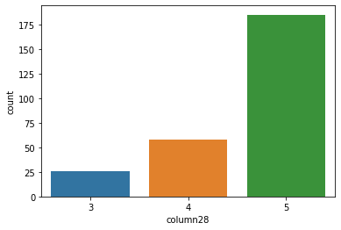
Column28- Being able to guarantee the privacy of the customer
185
58
26
Here we see that, 5 which represents strongly agree is the choice of maximum respondents.

Slide 51
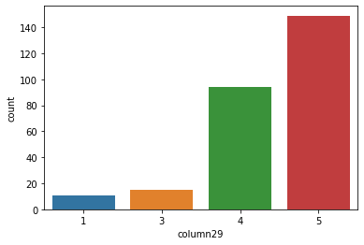
Column29- Responsiveness, availability of several communication channels (email, online rep, twitter, phone etc.)
149
94
15
11
Here we see that, 5 which represents strongly agree is the choice of maximum respondents.

Slide 52
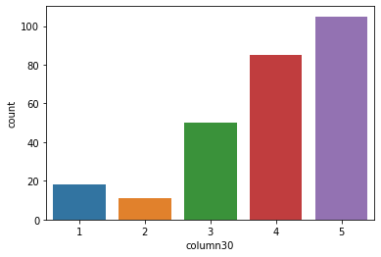
Column30- Online shopping gives monetary benefit and discounts
105
85
50
18
11
Here we see that, 5 which represents strongly agree is the choice of maximum respondents.

Slide 53
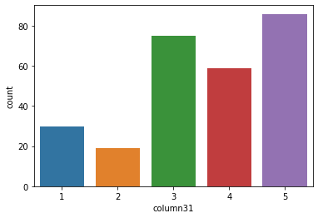
Column31- Enjoyment is derived from shopping online
86
75
59
30
19
Here we see that, 5 which represents strongly agree is the choice of maximum respondents.

Slide 54
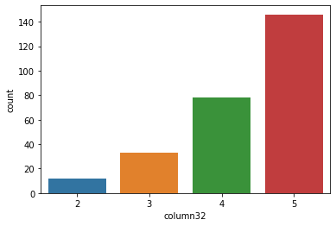
Column32- Shopping online is convenient and flexible
146
78
33
12
Here we see that, 5 which represents strongly agree is the choice of maximum respondents.

Slide 55

Column33- Return and replacement policy of the e-tailer is important for purchase decision
198
51
20
Here we see that, 5 which represents strongly agree is the choice of maximum respondents.

Slide 56
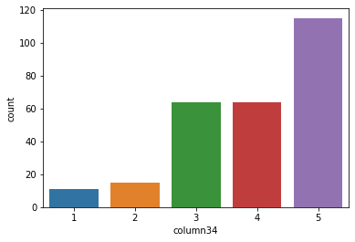
Column34- Gaining access to loyalty programs is a benefit of shopping online
115
64
64
15
11
Here we see that, 5 which represents strongly agree is the choice of maximum respondents.

Slide 57
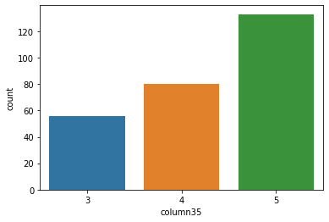
Column35- Displaying quality Information on the website improves satisfaction of customers
133
80
56
Here we see that, 5 which represents strongly agree is the choice of maximum respondents.

Slide 58
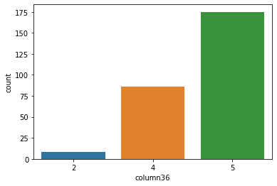
Column36- User derive satisfaction while shopping on a good quality website or application
175
86
8
Here we see that, 5 which represents strongly agree is the choice of maximum respondents.

Slide 59
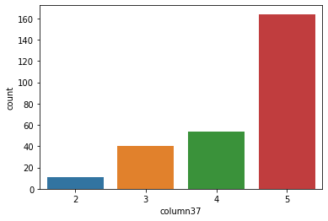
Column37- Net Benefit derived from shopping online can lead to users satisfaction
164
54
40
11
Here we see that, 5 which represents strongly agree is the choice of maximum respondents.

Slide 60
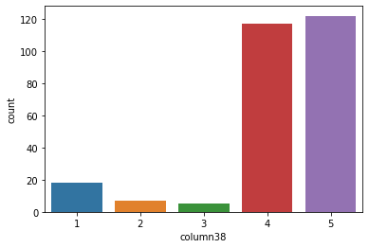
Column38- User satisfaction cannot exist without trust
122
117
18
7
5
Here we see that, 5 which represents strongly agree is the choice of maximum respondents.

Slide 61
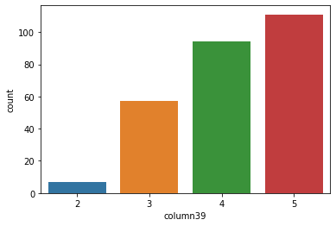
Column39- Offering a wide variety of listed product in several category
111
94
57
7
Here we see that, 5 which represents strongly agree is the choice of maximum respondents.

Slide 62
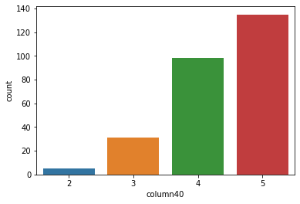
Column40- Provision of complete and relevant product information
135
98
31
5
Here we see that, 5 which represents strongly agree is the choice of maximum respondents.

Slide 63
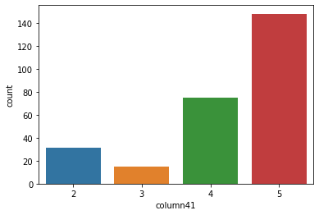
Column41- Monetary savings
148
75
31
15
Here we see that, 5 which represents strongly agree is the choice of maximum respondents.

Slide 64
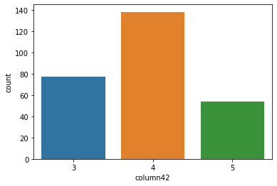
Column42- The Convenience of patronizing the online retailer
138
77
54
Here we see that, 4 which represents agree is the choice of maximum respondents.

Slide 65
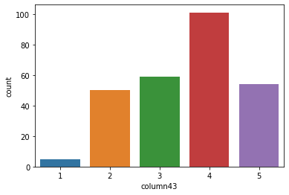
Column43- Shopping on the website gives you the sense of adventure
101
59
54
50
5
Here we see that, 4 which represents agree is the choice of maximum respondents.

Slide 66
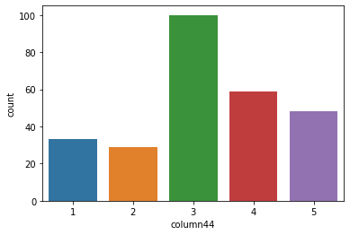
Column44- Shopping on your preferred e-tailer enhances your social status
100
59
48
33
29
Here we see that, 3 which represents indifferent is the choice of maximum number of respondents.

Slide 67
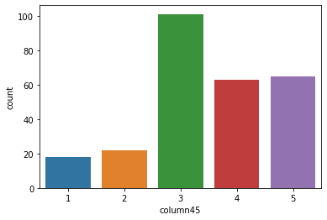
Column45- You feel gratification shopping on your favorite e-tailer
101
65
63
22
18
Here we see that, 3 which represents indifferent is the choice of maximum respondents.

Slide 68
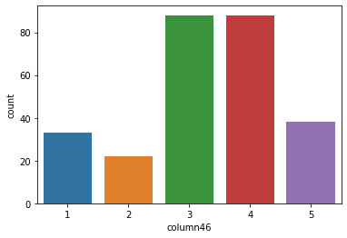
Column46- Shopping on the website helps you fulfill certain roles
88
88
38
33
22
Here we see that, 4 which represents agree and 3 which represents indifferent has the maximum number of preference.

Slide 69
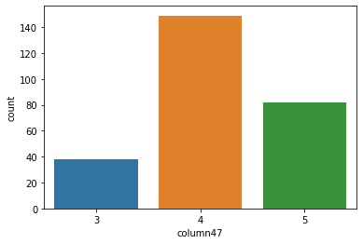
Column47- Getting value for money spent
149
82
38
Here we see that, 4 which represents agree is the choice of maximum number of respondents.

Slide 70
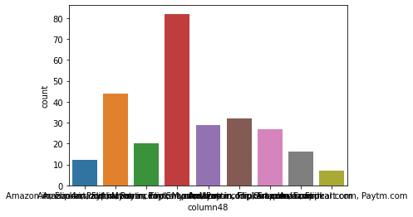
Column48- From the following, tick any (or all) of the online retailers you have shopped from
Amazon.in, Flipkart.com, Paytm.com, Myntra.com, Snapdeal.com 82
Amazon.in, Flipkart.com, Myntra.com, Snapdeal.com 44
Amazon.in, Flipkart.com 32
Amazon.in, Flipkart.com, Paytm.com, Snapdeal.com 29
Amazon.in, Flipkart.com, Snapdeal.com 27
Amazon.in, Paytm.com, Myntra.com 20
Amazon.in 16
Amazon.in, Paytm.com 12
Amazon.in, Flipkart.com, Paytm.com 7
Here we see that, maximum respondents gave shopped from all 5 online retailers.

Slide 71
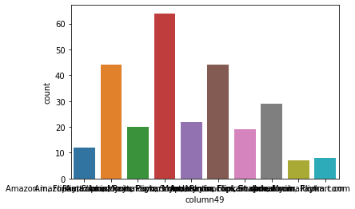
Column49- Easy to use website or application
Amazon.in, Flipkart.com, Paytm.com, Myntra.com, Snapdeal.com 64
Amazon.in, Flipkart.com, Myntra.com, Snapdeal.com 44
Amazon.in, Flipkart.com 44
Amazon.in 29
Amazon.in, Flipkart.com, Paytm.com, Snapdeal.com 22
Amazon.in, Paytm.com, Myntra.com 20
Amazon.in, Flipkart.com, Myntra.com 19
Paytm.com 12
Flipkart.com 8
Amazon.in, Paytm.com 7
Here we see that, maximum customers find all 5 online retailers easy to use.

Slide 72
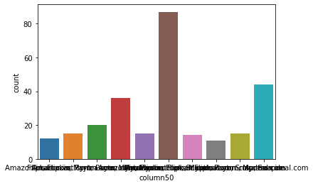
Column50- Visual appealing web-page layout
Amazon.in, Flipkart.com 87
Amazon.in 44
Amazon.in, Flipkart.com, Paytm.com, Myntra.com, Snapdeal.com 36
Amazon.in, Paytm.com, Myntra.com 20
Amazon.in, Myntra.com 15
Myntra.com 15
Flipkart.com, Myntra.com 15
Amazon.in, Flipkart.com, Myntra.com, Snapdeal.com 14
Flipkart.com 12
Amazon.in, Flipkart.com, Paytm.com, Snapdeal.com 11
Here we see that, maximum customers find Amazon and Flipkart most visually appealing web pages

Slide 73

Column51- Wide variety of product on offer
Amazon.in, Flipkart.com 130
Amazon.in 43
Amazon.in, Myntra.com 20
Flipkart.com, Myntra.com 15
Myntra.com 15
Amazon.in, Flipkart.com, Myntra.com, Snapdeal.com 14
Amazon.in, Flipkart.com, Paytm.com 13
Flipkart.com 12
Paytm.com 7
Here we see that, maximum customers think Amazon and Flipkart have the most wide variety of products on offer

Slide 74

Column52- Complete, relevant description information of products
Amazon.in, Flipkart.com 100
Amazon.in 43
Amazon.in, Flipkart.com, Paytm.com 24
Amazon.in, Paytm.com, Myntra.com 20
Amazon.in, Flipkart.com, Myntra.com 15
Amazon.in, Flipkart.com, Paytm.com, Myntra.com, Snapdeal.com 15
Amazon.in, Flipkart.com, Myntra.com, Snapdeal.com 14
Snapdeal.com 12
Flipkart.com, Snapdeal.com 11
Flipkart.com 8
Amazon.in, Flipkart.com, Snapdeal.com 7
Here we see that maximum customers think Amazon and Flipkart have the most complete information on product pages.

Slide 75

Column53- Fast loading website speed of website and application
Amazon.in 51
Amazon.in, Paytm.com 44
Amazon.in, Flipkart.com, Myntra.com 30
Amazon.in, Flipkart.com, Paytm.com, Myntra.com, Snapdeal.com 30
Amazon.in, Flipkart.com 30
Amazon.in, Flipkart.com, Snapdeal.com 25
Amazon.in, Flipkart.com, Paytm.com 25
Amazon.in, Flipkart.com, Myntra.com, Snapdeal.com 14
Snapdeal.com 12
Flipkart.com 8
Here we see that, most customers think Amazon is the fastest in loading website pages.

Slide 76

Column54- Reliability of the website or application
Amazon.in 61
Amazon.in, Flipkart.com 50
Amazon.in, Flipkart.com, Paytm.com 36
Amazon.in, Paytm.com, Myntra.com 35
Amazon.in, Flipkart.com, Snapdeal.com 18
Myntra.com 15
Flipkart.com 15
Amazon.in, Flipkart.com, Myntra.com, Snapdeal.com 14
Amazon.in, Flipkart.com, Paytm.com, Snapdeal.com 13
Paytm.com 12
Here we see that, maximum customers think Amazon is the most reliable online retailer.

Slide 77

Column55- Quickness to complete purchase
Amazon.com 66
Amazon.com, Flipkart.com, Paytm.com 47
Amazon.com, Flipkart.com 37
Amazon.com, Flipkart.com, Myntra.com 30
Paytm.com 25
Amazon.com, Paytm.com, Myntra.com 20
Amazon.com, Flipkart.com, Paytm.com, Myntra.com, Snapdeal 15
Flipkart.com 15
Flipkart.com, Myntra.com, Snapdeal 14
Here we see that, maximum respondents think Amazon takes the shortest time to complete a purchase.

Slide 78

Column56- Availability of several payment options
Amazon.in, Flipkart.com 65
Amazon.in, Flipkart.com, Myntra.com 40
Amazon.in, Flipkart.com, Patym.com, Myntra.com, Snapdeal.com 39
Amazon.in 23
Patym.com, Myntra.com 20
Amazon.in, Flipkart.com, Myntra.com, Snapdeal.com 19
Amazon.in, Flipkart.com, Snapdeal.com 18
Flipkart.com, Myntra.com, Snapdeal.com 14
Patym.com 12
Amazon.in, Patym.com 11
Flipkart.com 8
Here we see that, maximum customers think that Amazon and Flipkart have the most number of payment options available.

Slide 79

Column57- Speedy order delivery
Amazon.in 107
Amazon.in, Flipkart.com 82
Amazon.in, Flipkart.com, Snapdeal.com 36
Amazon.in, Flipkart.com, Myntra.com 15
Flipkart.com 15
Flipkart.com, Myntra.com, Snapdeal.com 14
Here we see that, maximum customers think that Amazon deliver orders in the shortest duration of time.

Slide 80

Column58- Privacy of customers’ information
Amazon.in 71
Amazon.in, Flipkart.com 54
Amazon.in, Flipkart.com, Myntra.com 25
Amazon.in, Flipkart.com, Paytm.com, Myntra.com, Snapdeal.com 24
Paytm.com 18
Myntra.com 15
Amazon.in, Paytm.com 15
Flipkart.com 15
Amazon.in, Flipkart.com, Myntra.com, Snapdeal.com 14
Amazon.in, Flipkart.com, Paytm.com 11
Amazon.in, Flipkart.com, Snapdeal.com 7
Here we see that, maximum customers think Amazon provides the most safe method and process of customer privacy.

Slide 81

Column59- Security of customer financial information
Amazon.in 51
Amazon.in, Flipkart.com, Paytm.com, Myntra.com, Snapdeal.com 42
Flipkart.com 33
Amazon.in, Flipkart.com, Snapdeal.com 25
Amazon.in, Flipkart.com 24
Amazon.in, Paytm.com, Myntra.com 20
Amazon.in, Snapdeal.com 19
Myntra.com 15
Paytm.com 15
Amazon.in, Flipkart.com, Myntra.com, Snapdeal.com 14
Amazon.in, Flipkart.com, Paytm.com 11
Here we see that, maximum number of customers think Amazon provides the maximum security of customer’s financial information.

Slide 82

Column60- Perceived Trustworthiness
Amazon.in 76
Amazon.in, Flipkart.com, Snapdeal.com 36
Amazon.in, Myntra.com 35
Amazon.in, Flipkart.com 31
Flipkart.com 27
Amazon.in, Flipkart.com, Myntra.com, Snapdeal.com 25
Myntra.com 15
Amazon.in, Flipkart.com, Paytm.com, Myntra.com, Snapdeal.com 13
Amazon.in, Flipkart.com, Paytm.com 11
Here we see that, maximum customers think Amazon is the most trustworthy online retailer amongst all.

Slide 83

Column61- Presence of online assistance through multi-channel
Amazon.in, Flipkart.com, Myntra.com, Snapdeal 61
Amazon.in 60
Amazon.in, Flipkart.com 39
Amazon.in, Snapdeal 26
Myntra.com 20
Amazon.in, Flipkart.com, Myntra.com 15
Amazon.in, Myntra.com 15
Amazon.in, Flipkart.com, Paytm.com 13
Paytm.com 12
Flipkart.com 8
Here we see that, maximum customers think Amazon, Flipkart, Myntra and Snapdeal provide the fastest resolution to customers.

Slide 84

Column62- Longer time to get logged in (promotion, sales period)
Amazon.in 57
Amazon.in, Flipkart.com 38
Paytm.com 38
Myntra.com 35
Amazon.in, Flipkart.com, Snapdeal.com 29
Snapdeal.com 25
Flipkart.com, Paytm.com 15
Flipkart.com, Paytm.com, Snapdeal.com 13
Amazon.in, Paytm.com 11
Flipkart.com 8
Here we see that, maximum customers think Amazon takes most time to get logged in during promotion/sales period.

Slide 85

Column63- Longer time in displaying graphics and photos (promotion, sales period)
Amazon.in, Flipkart.com 60
Amazon.in 39
Myntra.com 35
Snapdeal.com 34
Myntra.com, Snapdeal.com 25
Flipkart.com, Snapdeal.com 19
Paytm.com 15
Flipkart.com 15
Amazon.in, Myntra.com, Snapdeal.com 14
Amazon.in, Paytm.com 13
Here we see that, Amazon and Flipkart takes longer time to display photos and graphics as it has a wide variety of products.

Slide 86

Column64- Late declaration of price (promotion, sales period)
Myntra.com 75
Paytm.com 52
snapdeal.com 41
Flipkart.com 38
Amazon.in 38
Amazon.in, Paytm.com 13
Paytm.com, snapdeal.com 7
Amazon.in, Flipkart.com 5
Here we see that, maximum customers think Myntra is most delayed in announcing price of products during sales.

Slide 87

Column65- Longer page loading time (promotion, sales period)
Myntra.com 61
Paytm.com 59
Flipkart.com 32
Snapdeal.com 23
Amazon.in, Flipkart.com 18
Amazon.in 16
Paytm.com, Snapdeal.com 15
Amazon.in, Snapdeal.com 14
Amazon.in, Paytm.com 13
Flipkart.com, Snapdeal.com 11
Amazon.in, Paytm.com, Myntra.com 7
Here we see that, maximum customers think Myntra takes the longest to load pages during sales period.

Slide 88

Column66- Limited mode of payment on most products (promotion, sales period)
Snapdeal.com 87
Amazon.in 62
Flipkart.com 31
Amazon.in, Flipkart.com 29
Paytm.com 25
Paytm.com, Snapdeal.com 15
Amazon.in, Paytm.com 13
Myntra.com, Snapdeal.com 7
Here we see that, maximum customers think Snapdeal has least mode of payment options during sales period.

Slide 89

Column67- Longer delivery period
Paytm.com 72
Snapdeal.com 64
Flipkart.com 44
Amazon.in 37
Paytm.com, Snapdeal.com 26
Myntra.com 26
Here we see that, maximum customers think Paytm takes the longest to deliver producsts.

Slide 90

Column68- Change in website/Application design
Amazon.in 96
Paytm.com 63
Amazon.in, Flipkart.com 45
Myntra.com 30
Flipkart.com 20
Snapdeal.com 8
Flipkart.com, Myntra.com 7
Here we see that, maximum customers think Amazon has numerous changes in website and application designs.

Slide 91

Column69- Frequent disruption when moving from one page to another
Amazon.in 53
Myntra.com 52
Snapdeal.com 49
Paytm.com 39
Flipkart.com 26
Amazon.in, Flipkart.com 25
Myntra.com, Snapdeal.com 14
Flipkart.com, Snapdeal.com 11
Here we see that, maximum customers think Amazon has frequent disruption when moving from one page to another.

Slide 92

Column70- Website is as efficient as before
Amazon.in 94
Flipkart.com 47
Amazon.in, Flipkart.com 45
Amazon.in, Flipkart.com, Paytm.com 25
Amazon.in, Paytm.com 18
Paytm.com 15
Myntra.com, Snapdeal.com 14
Snapdeal.com 11
Here we see that, maximum customers think even after multiple upgrades Amazon’s website functions as efficiently as always.

Slide 93

Column71- Which of the Indian online retailer would you recommend to a friend?
Amazon.in 79
Amazon.in, Flipkart.com 62
Flipkart.com 39
Amazon.in, Myntra.com 30
Amazon.in, Paytm.com, Myntra.com 20
Amazon.in, Flipkart.com, Myntra.com 15
Amazon.in, Paytm.com 13
Flipkart.com, Paytm.com, Myntra.com, snapdeal.com 11
Here we see that, maximum customers think Amazon is the most efficient online retailer and they will recommend it to their friends.

Slide 94
FINDINGS:
After analyzing and visualizing all the columns of our dataset, we come to a conclusion that AMAZON is the most preferred and highly efficient online e-commerce site that provides customers with wide range of products, with offers and fast delivery.
There is a tough competition between Amazon and Flipkart during sales period but, Amazon defeats it with its customer centric behavior.

Slide 95
3.3 ENCODING OF DATAFRAME

Slide 96
Encoding:
Encoding a dataframe means changing the data type of a particular column to the required type as the dataset demands. There are various types on Encoding techniques:
I. Classic Encoders
We started with the most basic techniques, classic encoders. As the name suggests, these encoders are well known and widely used. Their concept is also pretty straight-forward.
II. Contrast encoders
Contrast encoding allows for recentering of categorical variables such that the intercept of a model is not the mean of one level of a category, but instead, the mean of all data points in the data set.
III. Bayesian Target Encoders
The general idea of this method is to take the target into account.

Slide 97
3.4 DESCRIBING THE DATASET

Slide 98

Describing:
Describing the dataset gives us an understanding of various values like count of the attribute,mean of that attribute, standard deviation, minimum, 25th percentile, median/50th percentile, 75th percentile and the maximum value of that attribute.

Slide 99
3.5 CHECKING FOR OUTLIERS

Slide 100
Outliers and their removal:
An outlier is an object that deviates significantly from the rest of the objects. They can be caused by measurement or execution error. The analysis of outlier data is referred to as outlier analysis or outlier mining.
Algorithm:
Calculate the mean of each cluster
Initialize the Threshold value
Calculate the distance of the test data from each cluster mean
Find the nearest cluster to the test data
If (Distance > Threshold) then, Outlier

Slide 101
3.6 SEPARATING THE DATASET INTO FEATURES AND TARGET

Slide 102
Target and Features:
In order to make a prediction (in this case, whether a customer will recommend the e-commerce site to a friend or not), one needs to separate the dataset into two components:
the dependent variable or target which needs to be predicted
the independent variables or features that will be used to make a prediction
For dataset splitting we give the following command:
features=df.drop('column71',axis=1)
target=df['column71']

Slide 103
3.7 SCALING THE DATASET

Slide 104
Scaling:
Scaling is a method of standardization that’s most useful when working with a dataset that contains continuous features that are on different scales, and you’re using a model that operates in some sort of linear space (like linear regression or K-nearest neighbors)
We will use Min-Max scaling technique for our dataset.
Min-Max scaling, We have to subtract min value from actual value and divide it with max minus min. Scikit-Learn provides a transformer called MinMaxScaler. It has a feature_range hyperparameter that lets you change the range if you don’t want 0 to1 for any reason.
After this, we split the data into train and test data. We now check the training and testing accuracy using random state for loop for the range (0,100).
We now check the r2 score and handle overfitting and underfitting of the data.
Cross validation gives us the training and testing score, model accuracy and we do this using the CV mean using the for loop function.
We now draw the Best Fit line to represent the number of datapoints which shows good fit of our model. Equation of this line is : y=mx+c

Slide 105
3.8 REGULARIZATION OF THE DATASET

Slide 106
Regularization:
Regularization is one of the most important concepts of machine learning. It is a technique to prevent the model from overfitting by adding extra information to it.
Techniques of Regularization
There are mainly two types of regularization techniques, which are given below:
Ridge Regression
Lasso Regression
For our dataset, we use the Lasso Regression for regularization giving the following command:
from sklearn.model_selection import GridSearchCV
from sklearn.linear_model import Lasso
parameters={'alpha': [.0001, .001, .01, .1, 1, 10],
'random_state':list(range(0,10))}
ls=Lasso()
clf= GridSearchCV(ls,parameters)
clf.fit(features_train,target_train)
print(clf.best_params_)
We get an output stating: {'alpha': 0.0001, 'random_state': 0}
We now do the final model training using the above best parameters and get the test score as 99.99%.

Slide 107
3.9 ENSEMBLE TECHNIQUE USED ON THE DATASET

Slide 108
Ensemble technique used:
Ensemble method in Machine Learning is defined as the multimodal system in which different classifier and techniques are strategically combined into a predictive model (grouped as Sequential Model, Parallel Model, Homogeneous and Heterogeneous methods etc.) Ensemble method also helps to reduce the variance in the predicted data, minimize the biasness in the predictive model and to classify and predict the statistics from the complex problems with better accuracy.
For our dataset, we use the Random Forest Regressor and get the output as:
{'criterion': 'mse', 'max_features': 'auto'}.
Now, we put the output and check the r2 and cross val score of the model. We get an output:
R2 Score: 99.998974488827
Cross val score: 99.99459877146819
We are getting model accuracy and cross validation both above 99% which shows our model is performing very good.

Slide 109
4. CONCLUSION AND FINDINGS

Slide 110
4.1 SAVING THE MODEL

Slide 111
Saving:
Pickle is a useful Python tool that allows you to save your ML models, to minimise lengthy re-training and allow you to share, commit, and re-load pre-trained machine learning models. Most data scientists working in ML will use Pickle or Joblib to save their ML model for future use.
We use the pickle.dump method to save the final model.

Slide 112
4.2 CONCLUSION

Slide 113
Conclusion:
To load a saved model from a Pickle file, all you need to do is pass the “pickled” model into the Pickle load() function and it will be deserialized. By assigning this back to a model object, you can then run your original model’s predict() function, pass in some test data and get back an array of predictions.
At the end, we load the saved model and check the predicted and original recommendations done by the customer for the e-commerce site.
We see that our model is performing very good with the accuracy score of 99.99%.

Slide 114
5. BIBLIOGRAPHY

Slide 115
References:
https://pbpython.com/pandas_dtypes.html
https://www.datasciencemadesimple.com/encode-decode-column-dataframe-python/#:~:text=encode%20%28%29%20function%20with%20codec%20%E2%80%98base64%E2%80%99%20and%20error,be%20Decode%20a%20column%20of%20dataframe%20in%20python%3A
https://www.geeksforgeeks.org/machine-learning-outlier/
https://medium.com/pythoneers/z-distribution-or-z-score-application-in-machine-learning-fbba081cd9fe
https://campus.datacamp.com/courses/hr-analytics-predicting-employee-churn-in-python/predicting-employee-turnover?ex=2
https://towardsdatascience.com/data-scaling-for-machine-learning-the-essential-guide-d6cfda3e3d6b
https://blog.finxter.com/the-complete-guide-to-min-max-scaler-in-machine-learning-with-ease/#:~:text=Min-Max%20scaling%20is%20a%20normalization%20technique%20that%20enables,range%20using%20each%20feature%E2%80%99s%20minimum%20and%20maximum%20value.
https://www.javatpoint.com/regularization-in-machine-learning
https://www.educba.com/ensemble-methods-in-machine-learning/
https://practicaldatascience.co.uk/machine-learning/how-to-save-and-load-machine-learning-models-using-pickle

Slide 116

THANK YOU!
PROJECT BY:-
Muskan Sureka
Internship Batch: 34

